Slide 1
Mogrifier LSTM
Gábor Melis, Tomáš Kočiský, Phil Blunsom
ICLR 2020

Slide 2
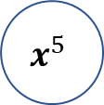
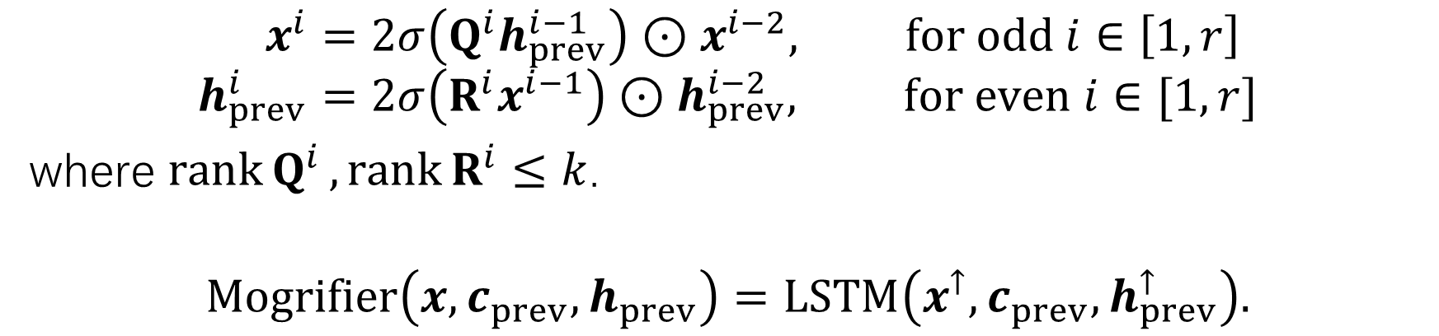
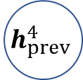
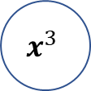

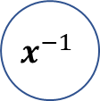
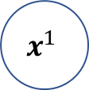

Model
$$h_{prev}^{0}$$
$$h_{prev}^{2}$$
$$h_{prev}^{4}$$
LSTM
$$x^{−1}$$
$$x^{1}$$
$$x^{3}$$
$$x^{5}$$
$$x^{i}=2σ\left(Q^{i}h_{prev}^{i−1}\right)⊙x^{i−2}, for odd i∈\left[1, r\right] \\ h_{prev}^{i}=2σ\left(R^{i}x^{i−1}\right)⊙h_{prev}^{i−2}, for even i∈[1, r]$$
where $\operatorname{rank}{Q^{i}},\operatorname{rank}{R^{i}}≤k$.
$$Mogrifier\left(x, c_{prev},h_{prev}\right)=LSTM\left(x^{↑}, c_{prev},h_{prev}^{↑}\right).$$
Notes:
In the lowermost layer, the first gating step scales the input embedding (itself a representation of the average context where the token occurs) depending on the actual context, result in a contextualized representation of the input.
The constant 2 ensures that randomly initialized Q_i, R_i matrices result in transformations close to identity.

Slide 3
Experiments – the case for small-scale
By choosing small enough datasets that model size is no longer the limiting factor, we get a number of advantages:
Generalization ability will be more clearly reflected in evaluations even without domain adaptation.
Turnaround time in experiments will be reduced, and the freed up computational budget can be put to good use by controlling for nuisance factors.
The transient effects of changing hardware performance characteristics are somewhat lessened.
Notes:
A recurring theme in the history of sequence models is that the problem of model design is intermingled with optimizability and scalability.
Scalability, on the other hand, is often optimized for indirectly.
To fit a larger dataset, model size must be increased. Thus the best performing models are evaluated based on their scalability.

Slide 4
Experiments – datasets
Word-level
PTB
Wikitext-2
Character-level
Enwik8
PTB
MWC
Notes:
MWC: Multilingual Wikipedia Corpus

Slide 5
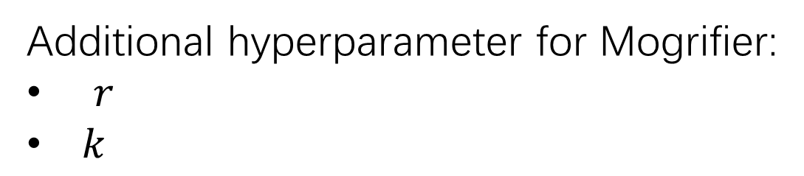
Experiments - setup
A black-box hyperparameter tuner based on batched Gaussian Process Bandits.
For LSTM, the tuned hyperparameters are following:
Input embedding ratio
Learning rate
L2 penalty
Input dropout
Inner layer dropout
State dropout
Output dropout
Additional hyperparameter for Mogrifier:
$r$
$k$

Slide 6
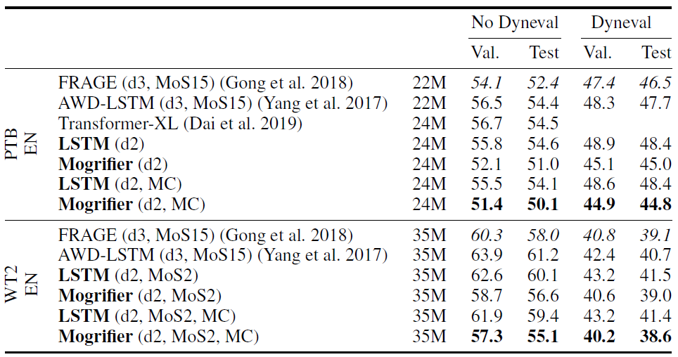
Experiments – results – word-level
Notes:
perplexity
Models with Mixture of Softmaxes (Yang et al. 2017) are denoted with MoS, depth N with dN.
MC stands for Monte-Carlo dropout evaluation.

Slide 7
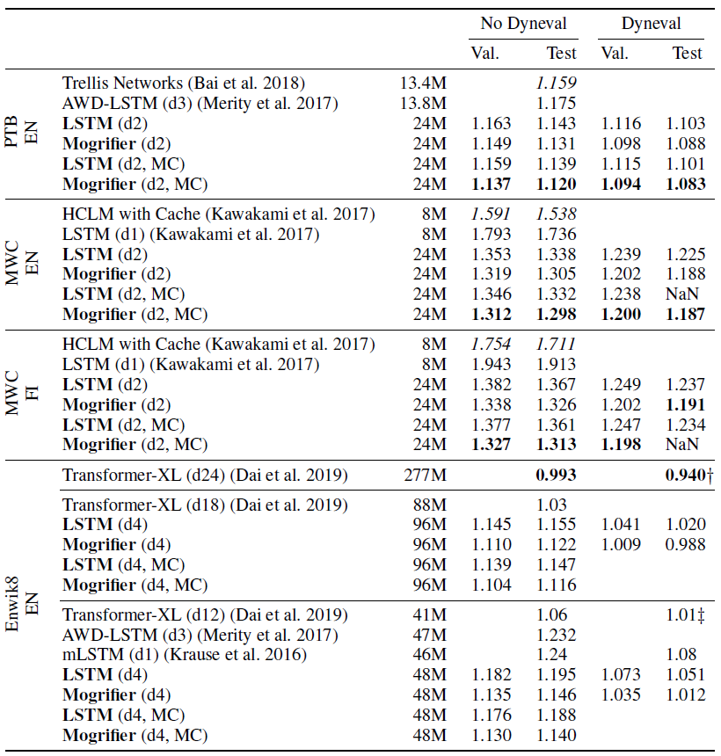
Experiments – results – character-level
Notes:
Bits per character
On most datasets, model size was set large enough for underfitting not to be an issue. This was very much not the case with Enwik8, so we grouped models of similar sizes together for ease of comparison.
Unfortunately, a couple of dynamic evaluation test runs diverged (NaN) on the test set and some were just too expensive to run (Enwik8, MC).

Slide 8
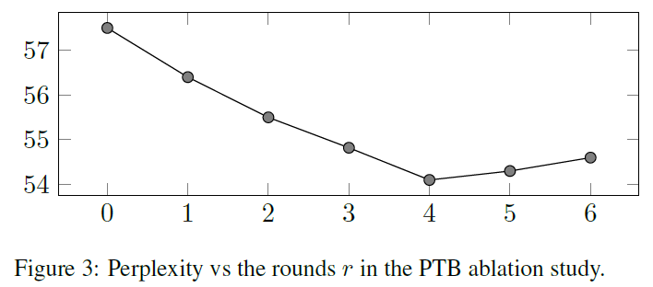

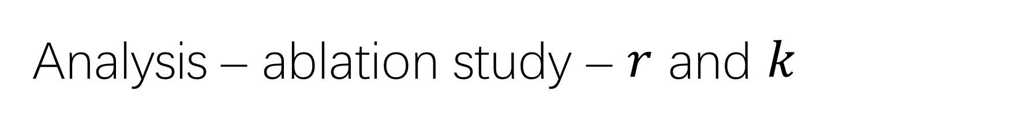
Analysis – ablation study – $r$ and $k$
The optimal settings were similar across all datasets, with $r∈\left\{5,6\right\}$ and $k∈\left[40,90\right]$.

Slide 9
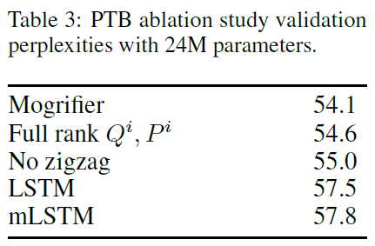
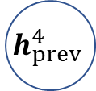


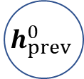
Analysis – ablation study – zig-zag
The comparison with no zigzag variant shows
that the iterative refinement does more than
simply widen the range of possible gating
values of $x$ and $h_{prev}$.
$$h_{prev}^{0}$$
$$h_{prev}^{2}$$
$$h_{prev}^{4}$$
LSTM
$$x^{−1}$$
$$x^{1}$$
$$x^{3}$$
$$x^{5}$$

Slide 10
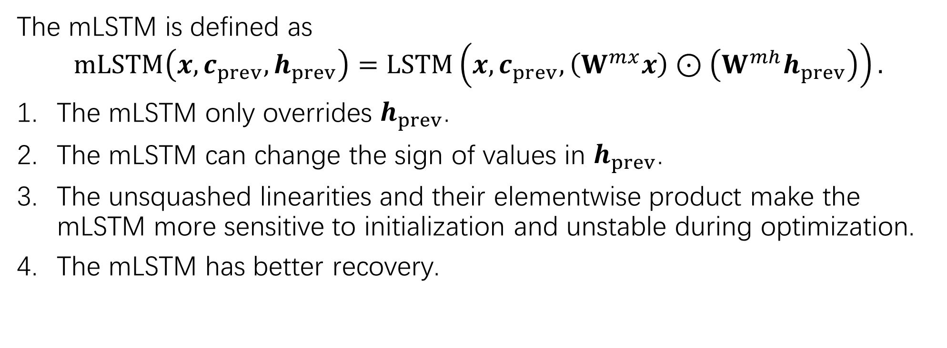
Analysis – comparison with mLSTM
The mLSTM is defined as
$$mLSTM\left(x, c_{prev},h_{prev}\right)=LSTM\left(x, c_{prev},\left(W^{mx}x\right)⊙\left(W^{mh}h_{prev}\right)\right).$$
The mLSTM only overrides $h_{prev}$.
The mLSTM can change the sign of values in $h_{prev}$.
The unsquashed linearities and their elementwise product make the mLSTM more sensitive to initialization and unstable during optimization.
The mLSTM has better recovery.

Slide 11
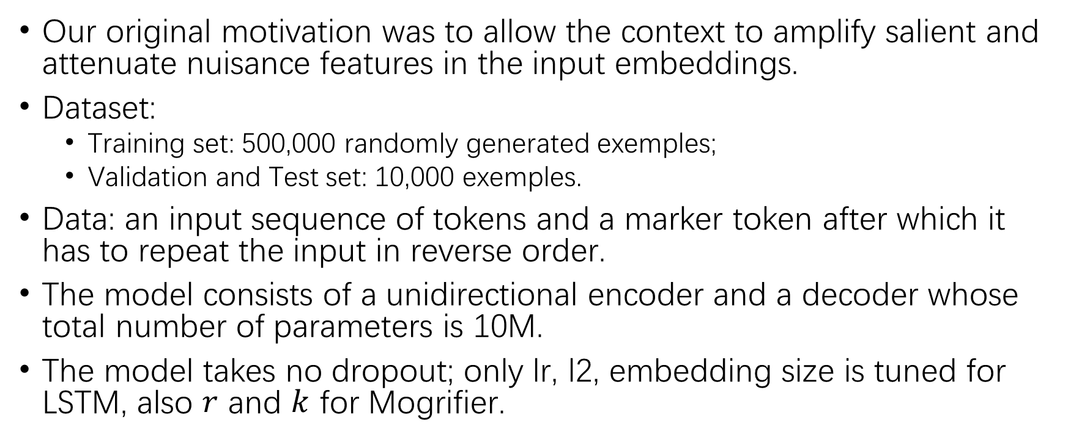
Analysis – the reverse copy task
Our original motivation was to allow the context to amplify salient and attenuate nuisance features in the input embeddings.
Dataset:
Training set: 500,000 randomly generated exemples;
Validation and Test set: 10,000 exemples.
Data: an input sequence of tokens and a marker token after which it has to repeat the input in reverse order.
The model consists of a unidirectional encoder and a decoder whose total number of parameters is 10M.
The model takes no dropout; only lr, l2, embedding size is tuned for LSTM, also $r$ and $k$ for Mogrifier.

Slide 12
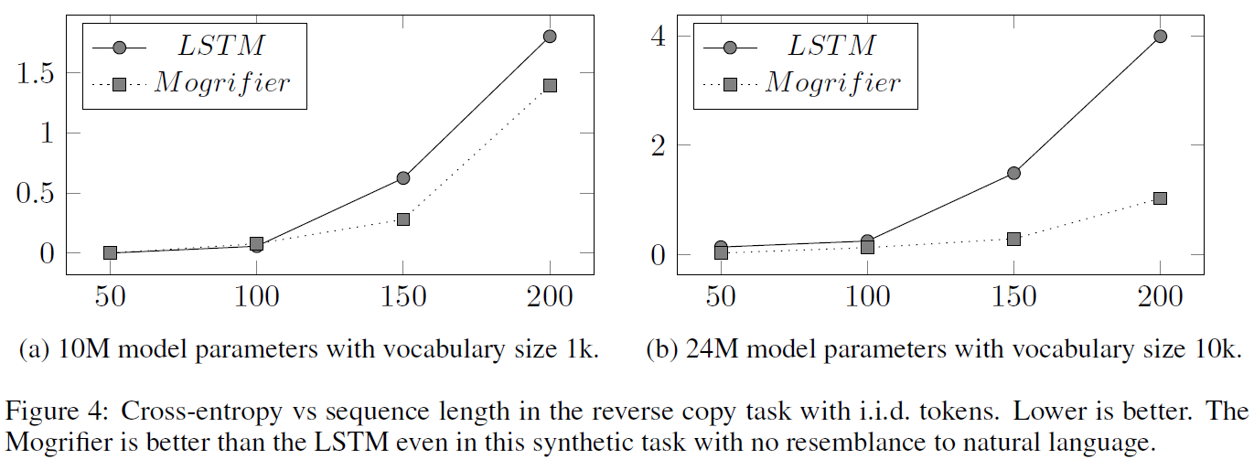
Analysis – the reverse copy task
Examining the best hyperparameter settings found, the embedding/hidden sizes for LSTM and Mogrifier are 498/787 vs 41/1054 at 150 steps, and 493/790 vs 181/961 at 200 steps.
Mogrifier is able to work with a much smaller embedding size.

Slide 13
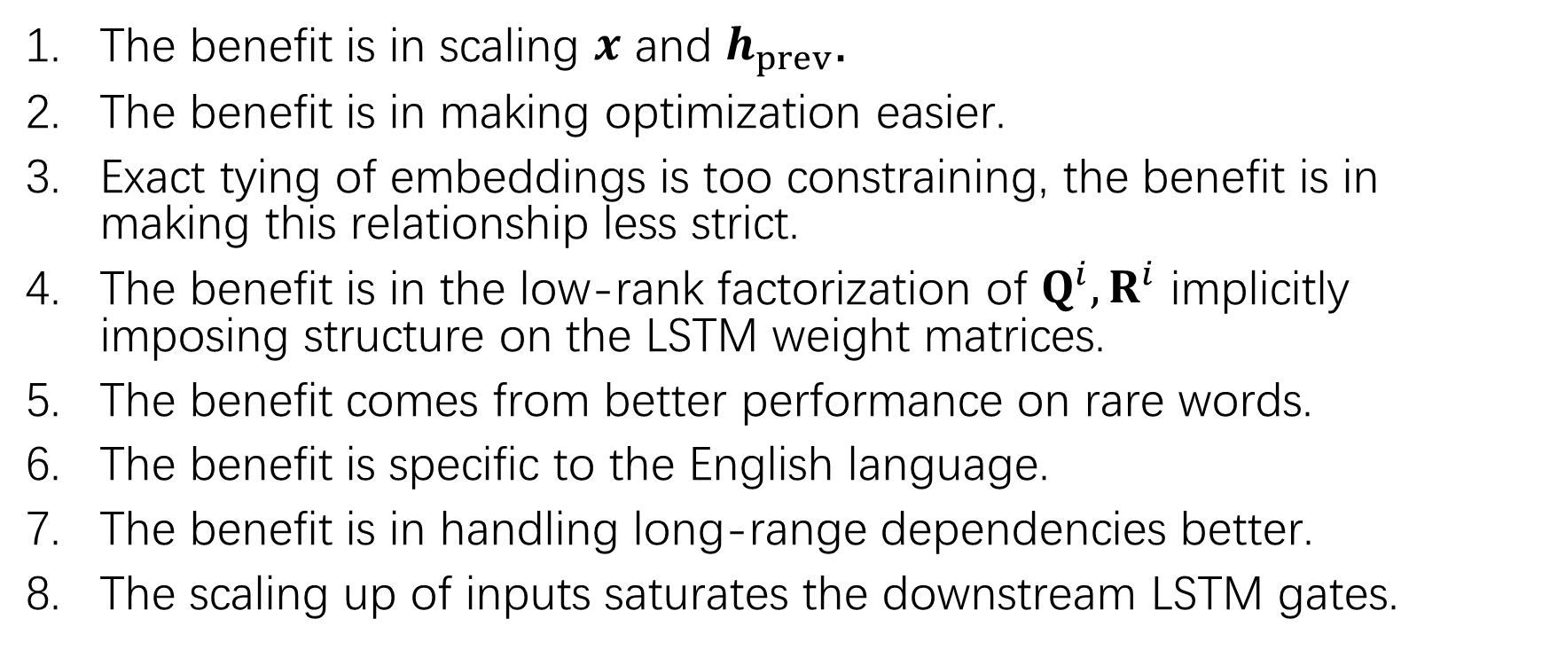
Analysis – what the Mogrifier is not
The benefit is in scaling $x$ and $h_{prev}$.
The benefit is in making optimization easier.
Exact tying of embeddings is too constraining, the benefit is in making this relationship less strict.
The benefit is in the low-rank factorization of $Q^{i},R^{i}$ implicitly imposing structure on the LSTM weight matrices.
The benefit comes from better performance on rare words.
The benefit is specific to the English language.
The benefit is in handling long-range dependencies better.
The scaling up of inputs saturates the downstream LSTM gates.

Slide 14
Conclusions and Future Work
Our original motivation for this work was that the context-free representation of input tokens may be a bottleneck in language models.
While it may be part of the explanation, this interpretation clearly does not account for the improvements brought by conditioning the recurrent state on the input and especially the applicability to character-level datasets.
Positioning our work on the Multiplicative RNN line of research offers a more compelling perspective.
Mogrifier on other architectures are possible, and other forms of parameterization of context-dependent transitions are also possible.

